Slide 1

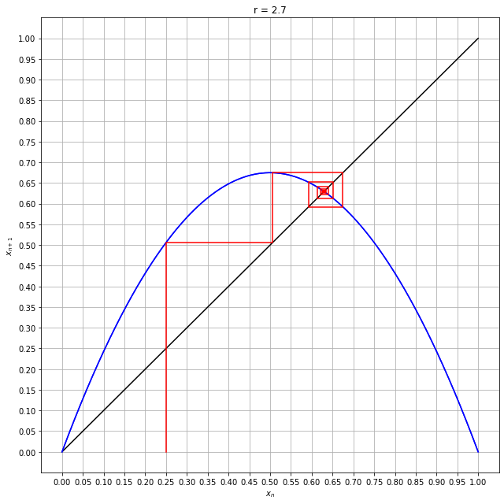
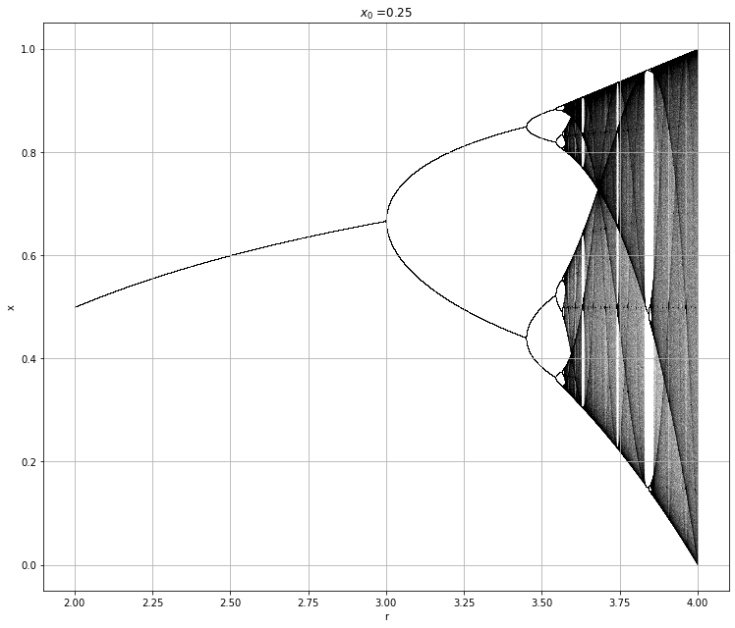
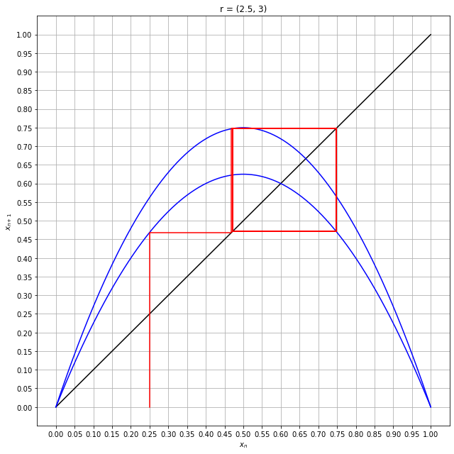
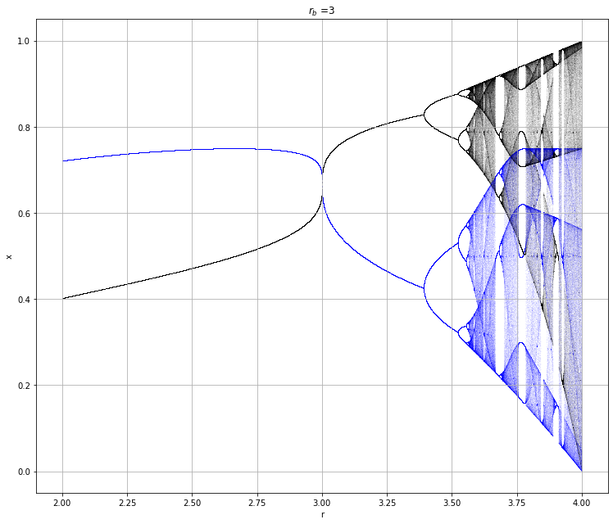
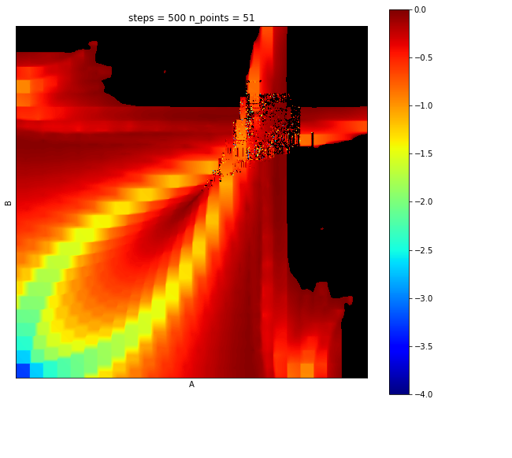
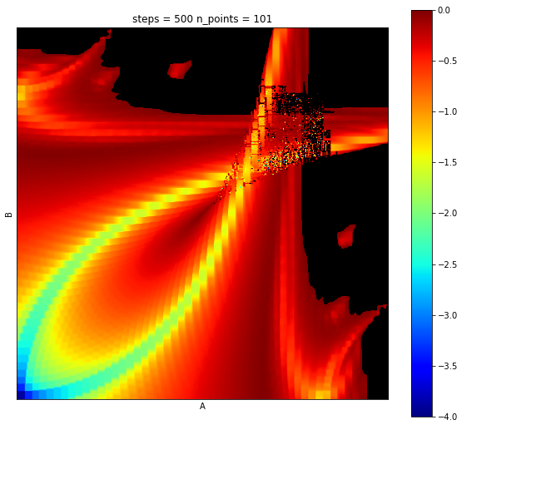

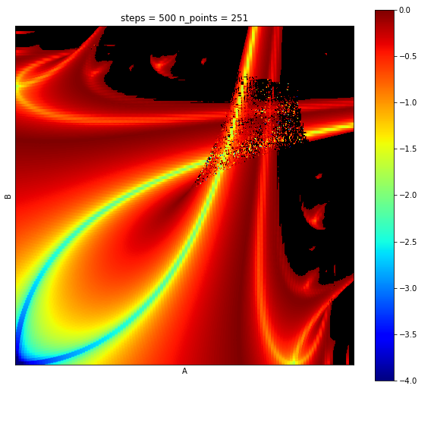
Invariant Measure Theory and Linear Approximations of Lyapunov Fractals Eric Botti and Shaun D. Ramsey, Ph.D. Department of Mathematics and Computer Science at Washington College
Abstract
Actuators, sensors, and computational components may be controlled intermittently in time and, thus, inconsistently perform any given operation. The inconsistencies in control operation directly influence the time domain of the control system. Previously, it was shown that chaos can be introduced into a system by changing only the time domain. Previously it was also that chaos exists in stochastic time domains in the same system. Can chaos be appropriately predicted by estimating the controlling system via linear approximation and an assumption of invariant weights across the domain? We answer this question in the affirmative. Using this technique, computation of a traditional Lyapunov fractal, SuPeR fractal, or any iterative fractal, no longer involves iterating over the deterministic steps in the time series, but can be estimated by linearly approximating the underlying continuous system using a system of linear equations. We show, via experiment, that in the limit, this estimation is equivalent to the iterative method.
Building a Fractal Iteratively – Cobweb Plots and Bifurcation Plots
Piecewise Linear Approximations with Invariant Measures - solving using a system of equations generated from the piecewise linear approximation of the logistic curve.
Future Work
Linear Approximations
Proof of Convergence
Linear Operators
The Logistic Equation - Describe it, where its used
The Lyapunov Exponent and Chaos - Describe it, Describe Chaos, Why do we care?

